Slide 1
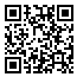
Industrial Pharmacy II
By
Dr. Mohammed Sabbar
4th Oct. 2018
http://bit.do/ex2a6

Slide 2
Liquids Dosage Forms

Slide 3
Formulation; stability and equipments.
Why important
Ease of adm.
Solution vs absorption
Stability

Slide 4
Formulation considerations
Like?
-Solubility
-Preservation
-Product Characteristics such as (sweetening agents, Viscosity control, Appearance)
-Stability
Manufacturing considerations
Like?
-Raw materials
-Equipments
-Compounding Procedure
-Packaging

Slide 5
Formulation considerations
Solubility
-Study or measurement
-Depend?
Dosage concentration and solubility in the final solvent(s) of the product
Which solvents are used
Enhance the solubility
pH
Co-solvency
Solubilization
Complexation
Hydrotrophy
Chemical modification
Dielectric Constant
Notes:
Co-solvency for weak electrolytes and nonpolar drugs. It is an addition of water miscible solvents

Slide 6
pH and buffers …………Eq ,???
As most of drugs are weak acids or bases so solubility affected by pH
And pH needs to control by buffers
Effect of other solvent on pH or pKa of drug?
Buffers requirements
1-has adequate capacity (how??)
2-Biologically safe
3-has little or No deleterious effect on stability of final product
4-permit acceptable flavoring or coloring of the product

Slide 7
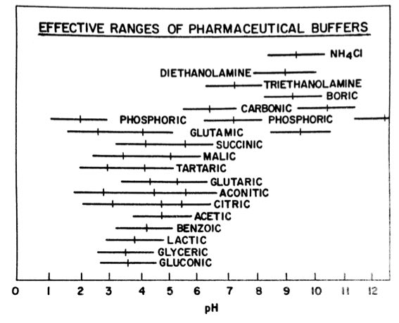
- Solubility
By pH (buffers)
https://www.aatbio.com/resources/buffer-preparations-and-recipes/
Notes:
Co-solvency for weak electrolytes and nonpolar drugs. It is addition of water miscible solvents

Slide 8
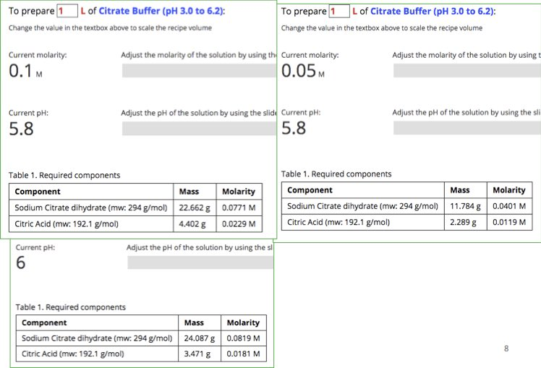

Slide 9
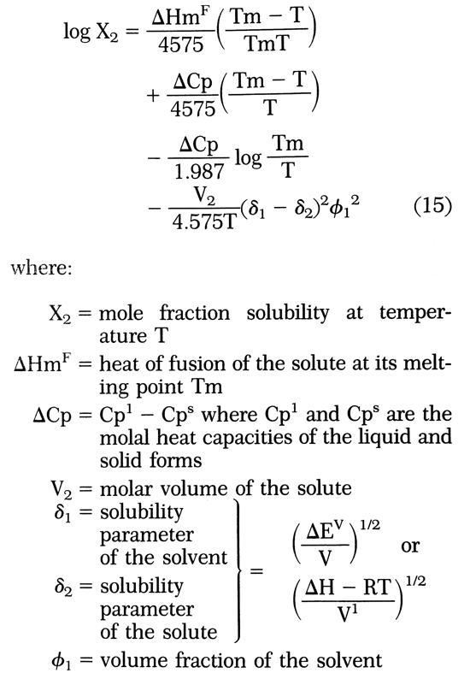
Formulation considerations
Co-Solvency
Hildbrand-Scott eq.
-when?
1-Weak electrolytes & nonpolar drugs
2- enhance solubility of volatile constit.
Dosage concentration vs solubility in the final solvent(s) of the product
Which solvents are used
Notes:
Hildbrand-Scott eq. concerns with solubility parameter that equal square root of the cohesive energy density

Slide 11
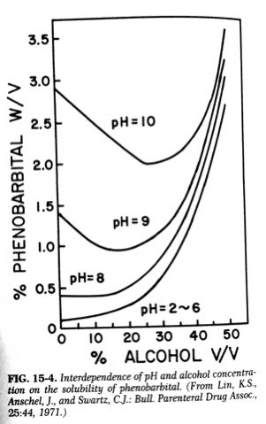
- Solubility
By Co-Solvency
Notes:
Co-solvency for weak electrolytes and nonpolar drugs. It is addition of water miscible solvents

Slide 12
Influence Of The Solvents On The Solubility Drugs
(Co-solvency)
Solubility | Solvents
1:1000 | Water
1:10 | Ethanol
1:40 | Chloroform
1:15 | Ether
The solubility of phenobarbital
What we have to do enhance the solubility at the critical pH

Slide 13
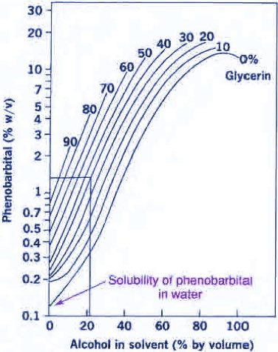
1.5%w/v is dissolved
22% alcohol,
40% glycerin
38% water

Slide 14
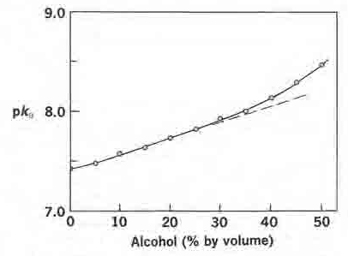
Combined effect of pH and solvents
Log S
Without alcohol
With alcohol
pH
Notes:
The solvent that enhance the solubility of drugs (weak acids and bases) they cause a change in the dissociation constant as shown in phenobarbital. Therefore,

Slide 15
Solvents and weak electrolytes
The solvent effect on the solubility of weak electrolytes by
Increase solubility of unionized species
Decrease the dissociation of weak electrolytes because of less polarity
Notes:
The solvent effects the solubility of a weak electrolytes in a buffer aqueous solution in two ways:
1- Increase solubility of unionized species.
2- Decrease the dissociation of weak electrolytes because of less polarity

Slide 16
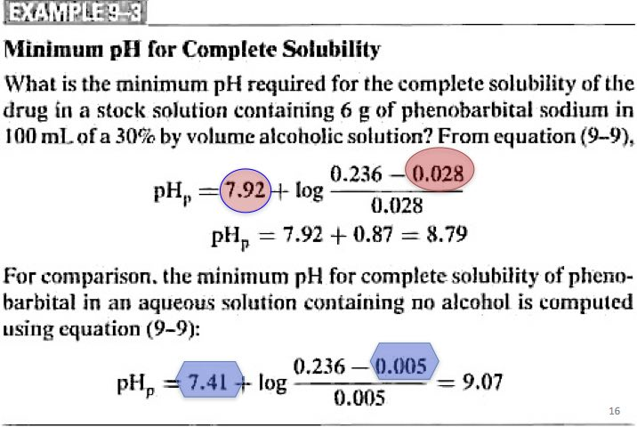
Notes:
From this example the solubility will increase (decrease the solubility by ionization) that which overcome by a more increase in the solubility of the un-ionized form. Therefore we can use a lower pH without precipitation occurs.

Slide 17
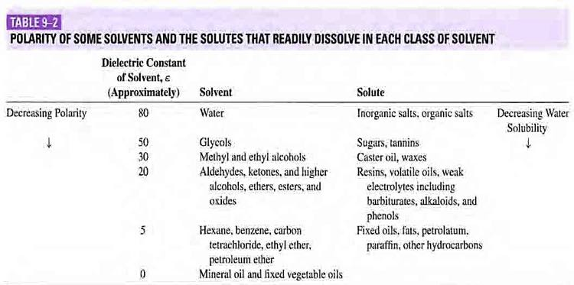
- Solubility
By Dielectric constant

Slide 18
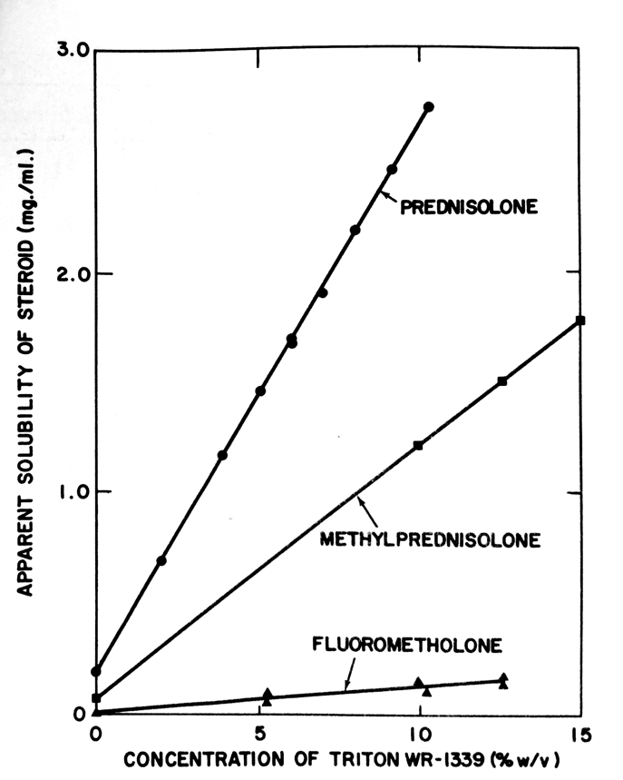
- Solubility
By Solubilization table 15-1
It is the spontaneous passage of poorly water-soluble solute molecules into an aqueous solution in which thermodynamically stable
Soap or detergent
SAA by colloidal micelle

Slide 19
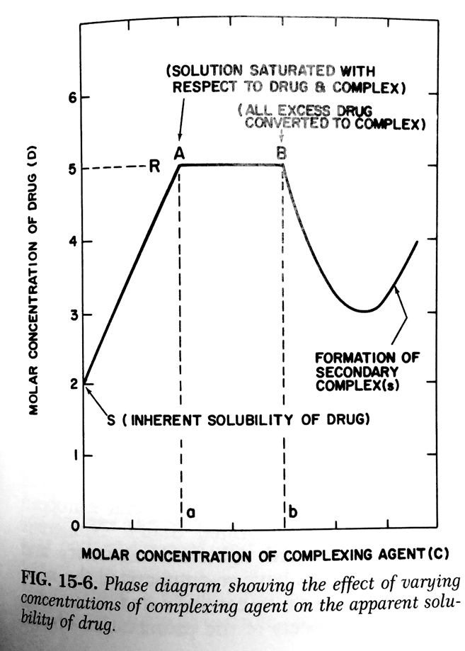
- Solubility
By Complexation
S_{T}=[D]+X[DxCy]
in some cases (sandwich)

Slide 20
- Solubility
By hydrotrophy
Which is the increase in the drug solubility in the final product as result of large amount of additives
It is mostly like complexation especially in the presence of
1-benzoate on caffeine
2-Sodium glycinate or acetate on theophylline
The application of Complexation and hdrotrophy are quite limited in pharmaceutical manufacturing

Slide 21
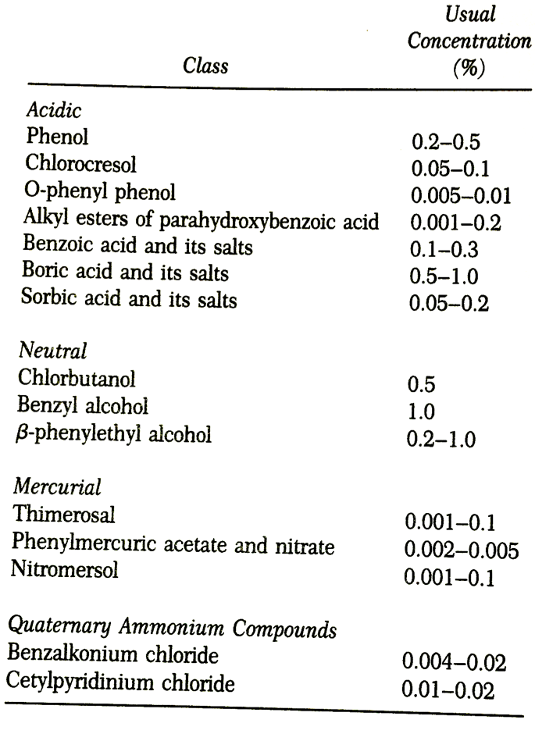
-Preservation
It is used to prevent microbial contamination
1-Broad spectrum
2-Stable during life time of product (physical, chemical and microbiological)
3-Nontoxic, non sensetive, adequately soluble, compatible and acceptable.

Slide 22
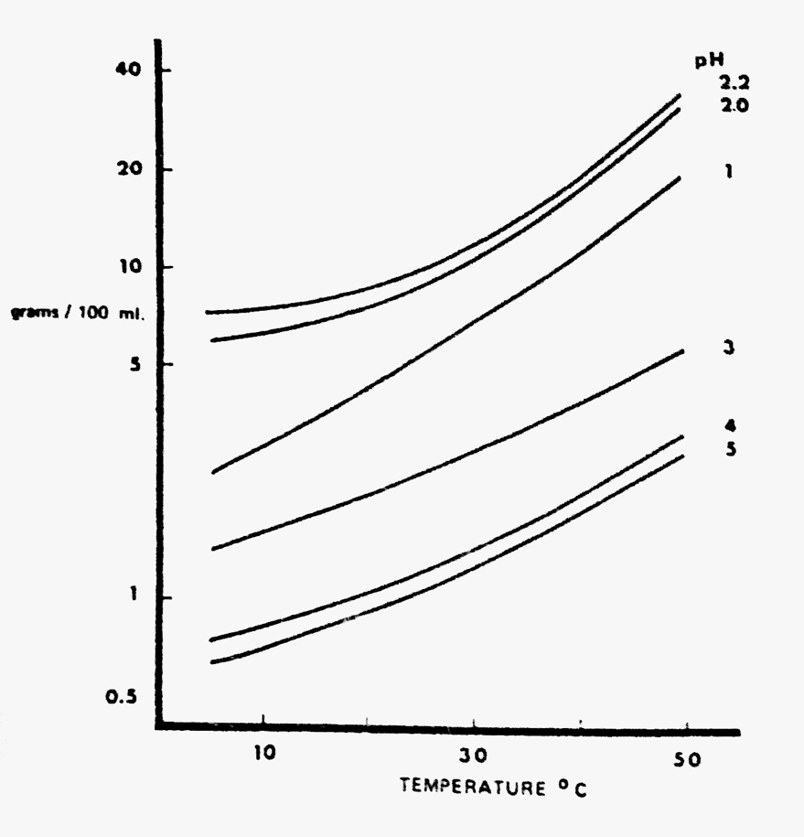
-Product Characteristics such as (sweetening agents, Viscosity control, Appearance)
Sweetening agents
1-Sucrose
2-Artificial (Aspartame (200), Saccharine (250-500)
Effect of pH, temp and time on stability of sweetening agent??

